Slide 1
Best Practices in
CMSD SLO Development
A professional learning module
for SLO developers and reviewers
Notes:
Welcome to this professional learning module on Best practices in CMSD SLO Assessment. The Cleveland Metropolitan School District has updated the approval criteria for reviewing and approving SLOs for the 2015-16 and this module will walk you step-by-step through each of these “essential elements” of the SLO, including examples from actual SLOs. Both teachers developing SLOs and reviewers of SLOs will benefit from this professional learning module.

Slide 2
Background
Quality review of CMSD SLOs in 2014–15.
Greatest quality deficiencies in
  Baseline and trend data
  Rationale for growth targets
Notes:
First we will provide some background for the updates to the criteria for SLO approval and this module. For the 2014-15 school year, a quality review was conducted of approved SLOs.
Results indicated a broad range of quality across the SLOs and identified the greatest deficiencies in quality in the baseline and trend data and rationale for growth targets sections of the SLO.

Slide 3
SLO Quality Review: 2014–15
Baseline and Trend Data | Rationale for growth targets
No summary of overall preassessment results No identification of student performance groups (e.g., basic, average, above-average students) No discussion of student strengths and weaknesses | Weak or no link provided between targets and contextual factors Amount (magnitude) of target adjustments not supported by rationale
Notes:
Specifically, for the Baseline and Trend Data component, common issues included the lack of a summary of the overall preassessment results, no identification of student performance groups according to these preassessment results and no discussion of the student strengths and weaknesses based on preassessment results and other data.
For the rationale for growth targets component, SLOs often failed to provide a strong link between the final SLO targets and the contextual factors that are supposed to be the basis of target adjustments, such as information student disabilities and English language learner status. Additionally, targets were commonly adjusted downward from the initial district-provided target by amounts that were not supported in the rationale.

Slide 4
Objectives of This Module
Identify available resources that support SLO development and review.
Identify the essential elements of an approvable SLO for each SLO component.
Provide examples of how to include these elements in the SLO.
Describe how the essential elements support good teaching practices.
Notes:
In response to these findings, this module was developed to achieve the following objectives…..
First, this module will briefly review the resources available to support SLO development and review
Second, we will identify the essential elements of an approvable SLO for each component of the SLO
Third, we will provide examples of how to include these elements in the SLO.
And lastly, we will describe how the essential elements support good teaching practices by connecting them to the Cleveland teaching framework wherever possible.

Slide 5
SLO Cycle for Teachers
Step 1: Gather and review available data.
Step 2: Write the SLO.
Step 3: Submit the SLO for approval.
Step 4: Meet to discuss progress.
Step 5: Review and reflect on SLO results.
Notes:
First, recall that the SLO cycle for teachers is a 5-step process beginning with gathering and reviewing data and ending with reflection on the SLO score results. This module supports the activities of SLO developers and reviewers through the first 3 steps of this cycle.

Slide 6
New and Improved Resources for
SLO Development, Review, and Approval
SLO Handbook
SLO Approval Checklist
SLO Development Companion
Guidance on Adjustments to Growth Targets
Understanding Growth Targets and Target Adjustment Guidance professional learning module
Assessment-specific guidance
Sample SLOs
Notes:
The following resources around SLO development and review have been created or improved for the 2015-2016 year: The SLO Handbook, the SLO Approval checklist, the SLO Development Companion, Guidance on Adjustments to Growth Targets, a professional learning module on understanding growth targets and adjusting targets, assessment-specific guidance for each course and/or grade level and sample SLOs demonstrating high-quality SLO development. We will now briefly describe each of these.

Slide 7
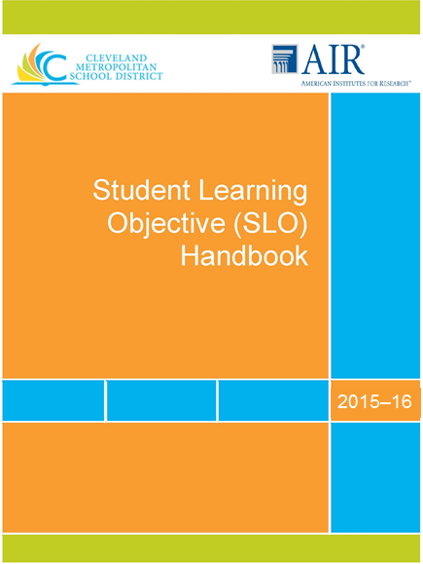
SLO Handbook
(See TDES Student Growth Measures)
Outlines all SLO policies and administrative procedures.
Provides component-by-component details for developing SLOs.
Identifies key deadlines.
Explains teacher categories.
Lists SLO assessments by subject
and grade (Appendix D).
Notes:
The SLO Handbook is your primary source for SLO-related information and is located, along with most SLO resources, at the TDES student growth measures website. The Handbook outlines all SLO policies and administrative procedures. It gives details and hints for developing and writing SLOs component-by-component. It provides key deadlines related to the submission and approval of SLOs. It explains how to determine your teacher category, which determines how your SLOs will be used in your overall evaluation. And it also lists all of the assessments that will be used for SLOs by subject and grade at Appendix D.

Slide 8
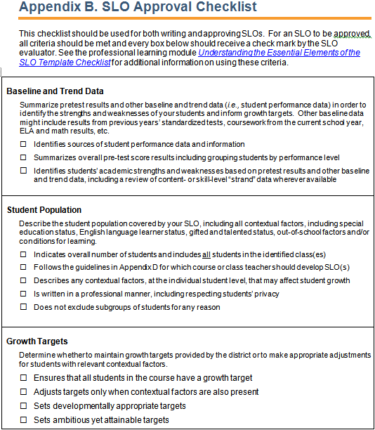
SLO Approval Checklist
Appendix B of Handbook
Lists the essential elements of each SLO component that should be present in order to approve SLOs.
Notes:
Next, it is highly recommended that you use the updated SLO Approval Checklist, located at Appendix B of the Handbook, as a guide for writing or reviewing SLOs. As you can see, the Approval checklist clearly lists each of the essential elements, component-by-component, of the SLO that should be present in order for the school principal to approve an SLO. This module with discuss each one of these essential elements momentarily.

Slide 9
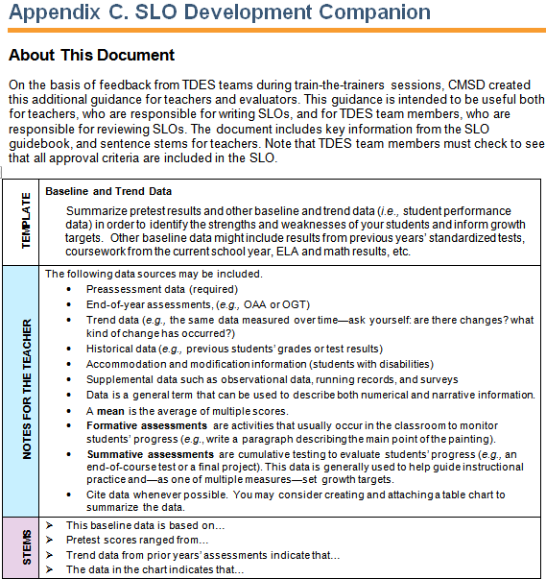
SLO Development Companion
Appendix C of SLO Handbook
Provides additional information
and sample content to support
high-quality SLO development.
Provides sentence stems
for inclusion in SLO.
Notes detailed guidance
and definitions.
Notes:
Appendix C of the Handbook is the SLO Development Companion. The companion provides additional information and actual sample content that you may use in your own SLOs, for each of the teacher-provided SLO components.

Slide 10
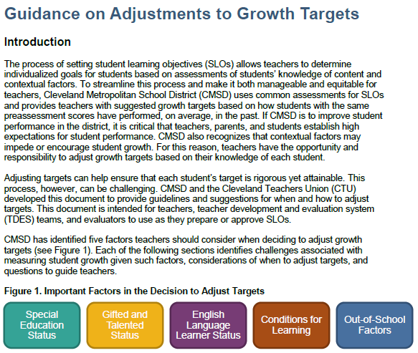
Guidance on Adjustments to Growth Targets
(See TDES Student Growth Measures)
Explains which contextual information can be used to justify target adjustments
Describes how the different contextual factors vary in their impact on growth
Notes:
The Guidance on Adjustments to Growth Targets describes the contextual factors that may be used adjust growth targets. This document gives detailed examples of each of the five allowable contextual factors and describes how each of them impact growth in different ways. This is an essential read to fully understand which adjustments to targets are allowable.

Slide 11
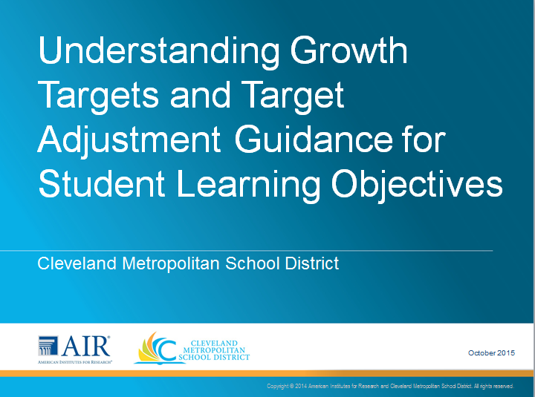
Professional Learning Module on Growth Targets
(See TDES Student Growth Measures)
Explains how growth targets that the district provides for teacher review are set.
Provides guidance on adjusting targets
Notes:
The next two resources are particularly helpful for making decisions around determining whether the SLO targets provided by the district are appropriate for your classroom or should be adjusted.
The newly created professional learning module called “Understanding Growth Targets and Target Adjustment Guidance for Student Learning Objectives” explains how the district sets the initial growth targets provided as guidance to teachers in the SLO template, considerations for deciding whether or not to adjust targets and steps for adjusting applicable targets.

Slide 12
Assessment-Specific Guidance
(See TDES Student Growth Measures)
Explains how growth is measured for each grade
and subject.
Provides guidance on acceptable range of target adjustments.
Types of data reports available
Notes:
This module may be used in conjunction with the assessment-specific growth target guidance that is available for each course and subject. This guidance explains how growth is measured for each subject and grade, provides specific guidance around the acceptable range of target adjustments that may be made by teachers and provides other information such as the types of reports that are available for the specific assessment, to support the identification of student strengths and weaknesses in the baseline data section. This is essential guidance for determining or reviewing growth targets.

Slide 13
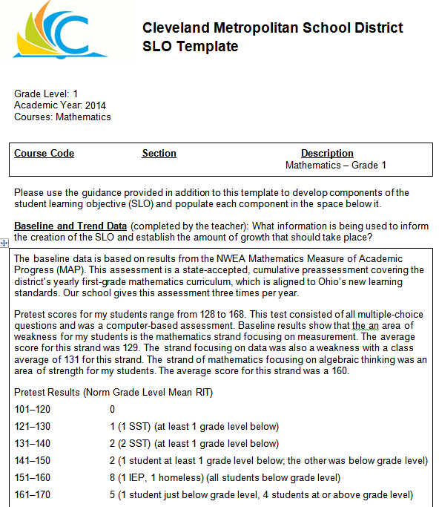
Sample SLOs
(See TDES Student Growth Measures)
Models the writing style and presentation of data that meet
the essential elements of the
SLO Approval Checklist.
Notes:
Finally, additional sample SLOs have been created which the model the writing and presentation of data that meet the essential elements of the SLO approval checklist.

Slide 14
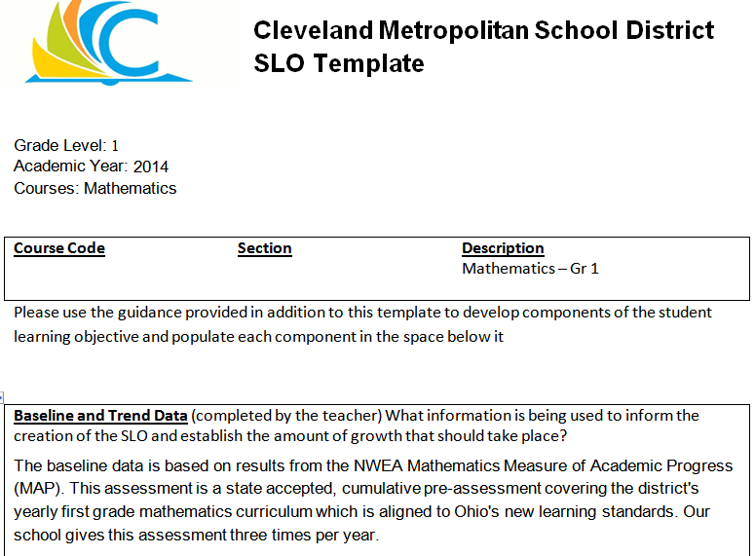
Refer to SLO Sample 1
(See TDES Student Growth Measures)
Notes:
This module will refer frequently to the new sample SLO for Grade 1 mathematics that is currently available at the CMSD website. We recommend that you pause the module now and to download and print SLO Number 1 from the TDES Student Growth Measures link provided here. You should also download and print a copy of the new SLO Approval Checklist from Appendix B of the Handbook as well. This module will refer to fairly detailed examples, so you are encouraged to pause the module at any point to learn at a comfortable pace. When you are ready to continue, unpause the module.

Slide 15
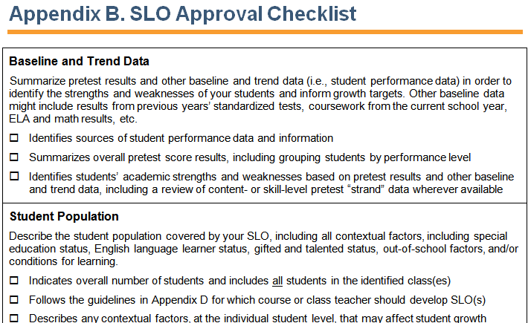
SLO Approval Checklist
Notes:
We will now review the essential elements of the SLO Approval Checklist, located at Appendix B of the SLO Handbook.
***LASER***
First note that each component of the SLO identified in the checklist has at least three essential elements, indicated next to check-boxes, that reviewers of SLOs should ensure have been met in order to approve an SLO.
If the SLO reviewer believes that a submitted SLO does not meet one or more of the essential elements, then the reviewer should provide written feedback to the teacher in order to collaborate towards bringing the SLO to an approvable level. It is recommended that the reviewer and teacher have a face-to-face conversation about the SLO in progress in order to share their lessons learned thus far.
We will now look at each of these essential elements so that SLO reviewers and SLO developers share a common understanding of expectations for approvable SLOs.

Slide 16
Components of the CMSD SLO
Baseline and trend data
Student population
Interval of instruction*
Standards and content*
Assessments*
Growth targets
Rationale for growth targets
*The district populates these components.
Notes:
Let’s quickly review the components of the SLO.
**LASER**
The first component is the baseline and trend section, which is the teacher’s analysis of preassessment data and other performance data sources.
The student population component is the teacher’s description of student backgrounds and circumstances, such as special education status or English learner status.
The interval of instruction is the first district-provided component, meaning the information has already been completed by the district in the SLO template and requires no further action or evaluation at the school level. The interval of instruction indicates the period of learning during which students’ growth will be measured.
The district also provides the standards and content component as well as the assessments section.
The district does provide initial growth targets, based on students’ preassessment scores; however, teachers must review the targets and determine whether to adjust or maintain them at the district-set levels.
In doing so, the teacher must also complete the Rationale section to justify why they decided to maintain or adjust the district-provided targets.

Slide 17
Baseline and Trend Data
Essential elements:
Identifies sources of student performance data
and information.
Summarizes overall pretest score results, including grouping students by performance level.
Identifies students’ academic strengths and weaknesses based on pretest results and other baseline and trend data, including a review of content- or skill-level preassessment strand data whenever available.
Notes:
There are three essential elements to the baseline and trend data section of the SLO.
It is essential that the SLO:
***Identifies sources of student performance data
and information.
***Summarizes overall pretest score results, including grouping students by performance level.
***Identifies students’ academic strengths and weaknesses based on pretest results and other baseline and trend data, including a review of content- or skill-level strand data whenever available.

Slide 18
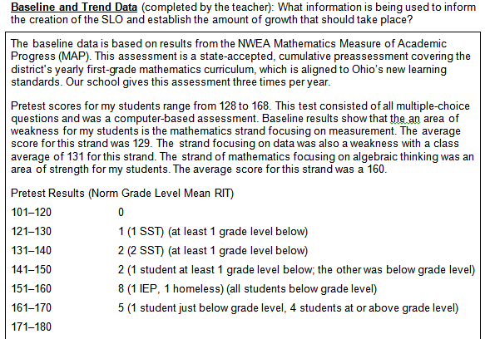
Baseline and Trend Data
SLO Sample 1
Notes:
Let’s refer to the baseline and trend data section of SLO sample 1, which you just printed out, as we explore these essential elements closer.
As we go through the following slides, keep in mind that these examples represent the most common ways of addressing the essential elements of the Baseline and Trend data section, however, they are not the only way of addressing them.

Slide 19

Baseline and Trend Data
Essential element 1: Identifies sources of student performance data and information.
All performance data sources are identified by name.
Notes:
First, the baseline section must specifically identify the source of performance data and information. This means that all performance data sources are identified by their proper name, not simply as “the preassessment” or “the pretest”. In the SLO sample here, the preassessment is identified fully as the NWEA Mathematics Measure of Academic Progress. This will help prevent confusion about the data sources.

Slide 20
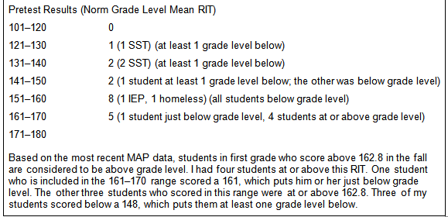
Baseline and Trend Data
Essential element 2: Summarizes overall pretest score results, including grouping students by performance level.
Student performance levels represented as score ranges with number of students
Notes:
Second, it’s essential that the baseline and trend data section summarizes the overall pretest score results, including grouping students by performance level.
****LASER POINTER***
The sample SLO has met this requirement by providing score ranges and the respective counts of students scoring within those ranges. In parenthesis, the teacher has also noted how the score compares to grade-level norms. This could also be provided in paragraph form, but providing it here in this tabular form, or by attaching a table to the SLO is highly recommended.
This isn’t the only way to present data to meet this requirement however. The teacher could divide the score ranges in other ways, to represent, for example below average, average and above average students.
Sorting your students into their ability levels serves an important purpose. The Cleveland teaching framework emphasizes the importance of teachers’ understanding of student ability levels in order to support the design of coherent instruction that is sensitive to students’ needs and, ultimately, to support differentiated instruction.
**UPDATE WITH NEW SCREENSHOT***

Slide 21

Baseline and Trend Data
Essential element 3: Identifies students’ academic strengths and weaknesses based on pretest results and other baseline and trend data, including a review of content- or skill-level preassessment strand data whenever available.
Break results down into content and skill areas whenever the data is available.
Notes:
Finally, the baseline and trend data section should identify students academic strengths and weaknesses based on pretest results and other baseline and trend data, including a a review of content- or skill-level preassessment strand data whenever it is available.
***laser****
The sample SLO meets this requirement by reporting the subscores of specific content areas that are reported on the NWEA vendor report. For this math preassessment then, students scored an average of 129 on all the test items dealing with measurement and an average of 131 on all the items dealing with data. These are areas of relative weakness for the teachers’ students compared to algebraic thinking, for which students scored on average of 160.
Analyzing results at the content and skill levels is important for various reasons. The first element of the CMSD teaching framework emphasizes the importance of teachers’ understanding of the content structure of their teaching discipline—that is, how the content breaks down into central ideas, prerequisite skills, and related strands. Designing coherent instruction relies on understanding the respective skill levels of students across these various content areas.
Note that other data sources can be used to supplement your analysis of strand data to identify student strengths and weaknesses. In rare cases where strand data for pretests are not available, data sources from other courses should in fact be used. For example, students’ reading skills are relevant to all courses. This math teacher could discuss students’ strengths or weaknesses in reading in terms of solving complex math word problems. Encore teachers could also discuss students’ reading strengths and weaknesses in the context of their curricula. Remember, however, that wherever strand data is available, it must be used to meet this requirement.

Slide 22
Student Population
Essential elements:
Indicates overall number of students and includes all students in the identified classes.
Follows the guidelines in Appendix D for which course or class teacher should develop SLOs.
Describes any contextual factors at the individual student level that may affect student growth.
Is written in a professional manner, including respecting students’ privacy.
Does not exclude subgroups of students for any reason.
Notes:
For the Student Population component of the SLO, it is essential that it
**Indicates the overall number of students and includes all students in the identified classes.
**Follows the guidelines in Appendix D for which course or class teacher should develop SLOs.
**Describes any contextual factors at the individual student level that may affect student growth.
**Is written in a professional manner, including respecting students’ privacy.

Slide 23
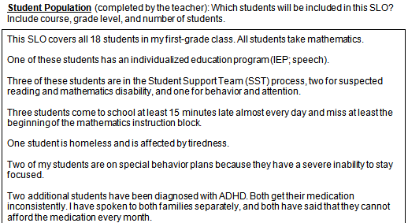
Student Population
SLO 1
Notes:
Let’s once again refer to sample SLO #1 for examples of these essential elements……
As with the Baseline data section, keep in mind that the following examples represent the most common ways of addressing the essential elements of the Student Population section, however, they are not the only way of addressing them.

Slide 24
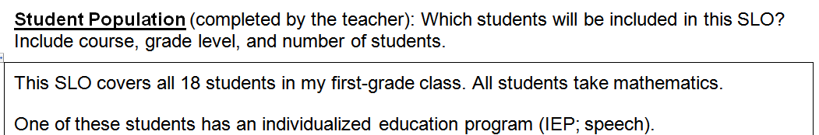
Student Population
Essential element 1: Indicates overall number of students and includes all students in the identified classes.
Essential element 2: Follows the guidelines in Appendix D for which course or class teacher should develop SLOs.
The SLO clearly indicates that all students are described in the SLO for the proper course or class.
Notes:
The first two elements can be met in a straightforward manner, by being sure to include a statement at the beginning of the Student population section that indicates the number of students included in the SLO, which should equal the number of students in the class, and by clarifying the grade level and course, indicated here as first-grade mathematics.

Slide 25
Student Population
SLO Handbook Appendix D
Essential element 2: Follows the guidelines in Appendix D for which course or class teacher should develop SLOs.
Notes:
For specific information regarding which course and grade the SLO should address, consult Appendix D of the SLO Handbook, which provides detailed information around the SLO assessments you will be using.

Slide 26
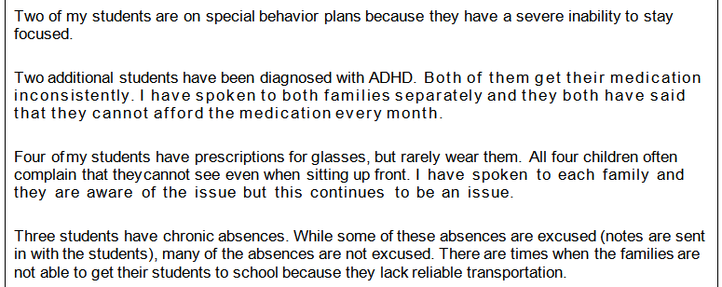
Student Population
Essential element 3: Describes any contextual factors at the individual student level that may affect student growth.
Provide counts of students and detailed descriptions of how students’ circumstances relate to achievement.
See Guidance on Adjustments to Growth Targets for potential contextual factors to consider.
Notes:
.
The CMSD teaching framework stresses understanding student backgrounds, in order to contextualize instruction appropriately, set appropriate instructional outcomes, help manage behavior, and communicate with families more meaningfully. The third essential element of the Student Population component is for teachers to describe this background information, known as “contextual factors”, at the individual student level, including any factors that may affect student growth. After describing the factors here, the SLO developer should then incorporate them into the rationale section in a discussion of how they justify either maintaining or adjusting the district-provided growth targets.
***LASER***
The sample SLO describes various kinds of contextual factors including special behavior plans, the diagnosis of ADHD, issues around students’ vision, and chronic absences. While it is acceptable to describe absences in the Student Population section, absences should not be used to justify target adjustments in the rationale section unless they are connected to other allowable contextual factors***

Slide 27
Student Population
Essential element 3: Describes any contextual factors at the individual student level that may affect student growth.
Consult Guidance on Rationale to Support Growth Target Adjustments regarding contextual factors that may impact student growth:
Special education status
English language learner
Gifted and talented
Out-of-school factors
Conditions for learning
Notes:
These allowable contextual factors fall into one of the following five categories: special education status, English language learner status, being identified as gifted and talented, out-of-school factors or conditions for learning. See the Guidance on Adjustments to Growth Targets guidance at the TDES student growth measures portal for an in depth discussion of these categories of contextual factors.

Slide 28
Student Population
Privacy is maintained by using counts of students, not students’ names.
Essential element 4: Is written in a professional manner, including respecting students’ privacy.
Essential element 5: Does not exclude subgroups of students for any reason.
Notes:
The fourth essential element of the Student Population section is that it is written in a professional manner that respects students’ privacy. It is not appropriate to use students’ names in the Student Population section—teachers should therefore provide the count of students who have certain backgrounds.
The fifth essential element is that the SLO does not include any subgroups. Remember that your SLO must include all students in your class regardless of their backgrounds.

Slide 29

Interval of Instruction
Essential elements:
Matches the length of the course (i.e., semester or year).
Notes:
We will now review the 3 components of the SLO that are district-provided only briefly, since teachers do not develop these sections nor to reviewers evaluate them. Nevertheless, it is important for educators to read these sections, incorporate their content into their work, and understand their essential elements.
The first component provided by the district is the interval of instruction. The interval of instruction simply clarifies the length of the course, that is, the duration across which student growth will be measured. In our sample SLO, student growth will measured by assessments administered in october 2013 and April of 2014.

Slide 30
Standards and Content
Essential elements:
Represents the big ideas or domains of the content taught during the interval of instruction.
Specifies how the SLO will address applicable standards from the highest ranking of the following: (1) Common Core State Standards, (2) Ohio Academic Content Standards, or (3) national standards put forth by educational organizations.
Notes:
The Standards and content component is also populated by the district.
It is essential that this component :
**Represents the big ideas or domains of the content taught during the interval of instruction and that it
**Specifies how the SLO will address applicable standards from the (1) Common Core State Standards, (2) Ohio Academic Content Standards, or (3) national standards put forth by educational organizations.

Slide 31
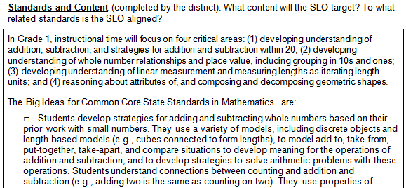
Standards and Content
Essential element 1: Represents the big ideas or domains of the content taught during the interval of instruction.
Notes:
In our sample SLO, the big idea of the content is represented by an overall statement of intent of the learning that the teacher wants students to achieve over the course.

Slide 32
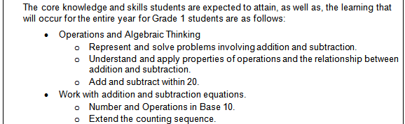
Standards and Content
Essential element 2: Specifies how the SLO will address applicable standards from the highest ranking of the following: (1) Common Core State Standards, (2) Ohio Academic Content Standards, or (3) national standards put forth by educational organizations.
Notes:
The second essential element is that the SLO then breaks the big content idea down into the specific academic standards. Here we see that the teacher has itemized math standards that are captured in the big idea. While teachers do not provide the information for this section of the SLO, it is very important that they are familiar with it so that they can align their instruction with the indicated standards.

Slide 33
Assessments
Essential elements:
Identifies assessments that grade-level and content-level district experts have reviewed to measure course content effectively and student learning reliably, as intended.
Includes measures with sufficient stretch so that all students may demonstrate learning or identifies supplemental assessments to cover all ability levels in the course.
Provides a plan to combine assessments if multiple summative assessments are used.
Follows state guidelines for appropriate assessments.
Notes:
The Assessment component of the SLO very briefly states which assessments are used, however, the assessments themselves should demonstrate the 4 essential elements itemized here.
The first two elements are worth noting:
**First, it is essential that the assessments measure course content effectively and student learning reliably, as intended.
As noted previously, appendix D identifies assessments that meet this criteria for each grade and course.
**secondly, the assessment should include measures with sufficient stretch so that all students may demonstrate learning or otherwise identify supplemental assessments to cover all ability levels in the course. In other words, the assessment should include questions of varying difficulty level that allow both higher- and lower-performing students to demonstrate growth.
**Provides a plan to combine assessments if multiple summative assessments are used.
**Follows state guidelines for appropriate assessments.

Slide 34
Growth Targets
Essential elements:
Ensures that all students in the course have a
growth target.
Adjusts targets only when contextual factors also
are present.
Sets developmentally appropriate targets.
Sets ambitious yet attainable targets.
Notes:
We now return to the teacher-completed components of the SLO. The district does provide initial growth targets based on preassessment scores in the SLO template, however, teachers are expected to review these targets and use the contextual information they provided in the student population component to determine whether targets should be maintained at the district-set level or adjusted.
It is essential, first, that all students in the course have a growth target.
Second, the SLO should adjust targets only for students for whom contextual factors are also
present, as described in the Student Population and Rationale components.
Third , targets should be developmentally appropriate.
Finally, the targets should be ambitious yet attainable.

Slide 35
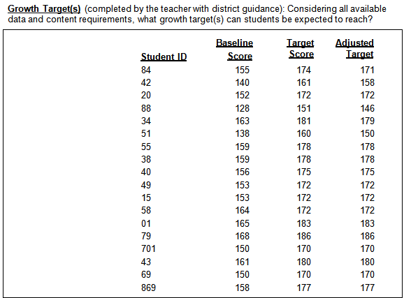
Growth Targets
Essential element 1: Ensures that all students in the course have a growth target.
Notes:
The first essential element ensures that all of the students enrolled in the class at the time the SLO is developed receive a target. One easy way to ensure this is to count the number of targets provided and compare them to the number of students in the class as identified in the Student Population section. Any student who took the preassessment identified in the SLO must receive a target, regardless of which teacher administered the preassessment.

Slide 36
Growth Targets
Essential element 2: Adjusts targets only when contextual factors also are present.
Ensure that these adjusted targets are accompanied by allowable contextual factors
Notes:
The second essential element is that target adjustments are made only for those students who also have allowable contextual factors, as identified in the Guidance on Adjustments to Growth Targets.
For example, we see in the adjusted target column in SLO sample 1 that the teacher has adjusted 4 of the original district targets downward, anywhere from 2 to 5 points. The reviewer should review the contextual factors in the Student Population and Rationale sections for each of the students with adjustments and ensure that the factors used to justify these adjustments are allowable as discussed in the Guidance on Adjustments to Growth Targets.

Slide 37
Growth Targets
Essential element 2: Adjusts targets only when contextual factors also are present.
Consult Guidance on Adjustments to Growth Targets regarding contextual factors that may justify target adjustments, such as:
Special education status
English language learner
Gifted and talented
Out-of-school factors
Conditions for learning
Notes:
Remember that the Guidance lists five categories of contextual factors that may be used to adjust targets.

Slide 38
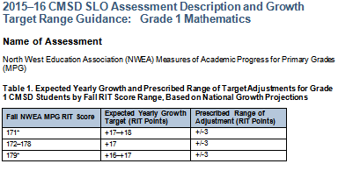
Growth Targets
Essential element 3: Sets developmentally appropriate targets.
Essential element 4: Sets ambitious yet attainable targets.
Consult assessment-specific guidance for your preassessments and postassessments
Most students who received between 172-178 on the preassessment scored within three points (+/-3) of the expected growth (17 points) on the postassessment (i.e., most students grew between 14 and 20 points).
Notes:
While the second essential element refers to the reason that targets are adjusted, the third and fourth essential elements refer to the amount that the targets are adjusted by—otherwise known as the magnitude of the adjustment. The magnitude of adjustment should be both developmentally appropriate for students and provide an ambitious but attainable target.
To support this determination, teachers and reviewers should refer to the assessment-specific guidance identified at the beginning of this module. This guidance provides a range of growth that most students who scored a given preassessment score achieved.
***LASER***
In the table provided here taken from that guidance, we see first that, for any student scoring between 172 and 178 on their preassessment, an initial target has been set by the district at growth of 17 points. This target is the average growth of other students with the same preassessment scores in previous years of testing. We also see in the last column that most students scored within three points above or below that average growth. In other words, most students grew between 14 and 20 points, which would be an generally acceptable range of adjustments, assuming the teacher provides an appropriate rationale.
The teacher and reviewer need to consider this information carefully when developing and reviewing the SLO. In general, targets should not automatically be adjusted by the full amount allowed by this range. Adjustments should vary according to how impactful different contextual factors may be on student growth.

Slide 39
Rationale for Growth Targets
Essential elements:
Provides justification for both maintaining and adjusting targets for all students with contextual factors.
Provides strong justification based on data for all adjusted growth targets, including effectively connecting contextual factors and baseline and trend data.
Adjusts targets by magnitudes that are consistent
with contextual factors and available data.
Explains how targets align with broader school
and district goals.
Notes:
The Rationale section should link contextual factors to target adjustments in an appropriate manner, as outlined in four essential elements.
First, the rationale should provide justification for both maintaining and adjusting targets for all students with contextual factors.
Second, the rationale should provides strong justification, based on data, for all adjusted growth targets, including effectively connecting contextual factors as well as baseline and trend data, to the target adjustments
Third, the rationale should provide explanations around the magnitudes of adjustments that are consistent
with contextual factors and available data.
Finally, the rationale should explain how targets align with broader school and district goals.

Slide 40
Rationale for Growth Targets
Sample SLO 1
Notes:
Once again, we will view SLO sample 1 for our examples.

Slide 41
Rationale for Growth Targets
Essential element 1: Provides justification for both maintaining and adjusting targets for all students with contextual factors.
Cross-reference with the student population section to ensure that the rationale section addresses all contextual factors described in Guidance on Adjustments to Targets.
Student Population
Are absences described in the student population section linked to allowable contextual factors in the rationale?
Notes:
The first essential element is that the rationale section should provide justification for both maintaining and adjusting targets for all students with contextual factors. This means that for all the students who had contextual factors described in the Student Population section, the rationale section should explain why the teacher decided to either adjust or maintain the district provided target.
So when reviewing the Rationale section, our first step is to cross-reference the Student Population section, provided here ***LASER***, to ensure that all of the contextual factors from it are accounted for.
Remember that in the student population section the teacher had described several students who have chronic absences. We know from our Guidance on Adjustments to Growth Targets, which describes allowable contextual factors, that absences alone are not justifiable reasons for adjustments. They must be connected to an allowable contextual factor. For example, if a student was absent due to an extended illness, that could be an allowable rationale for adjustments that incorporates absences.

Slide 42
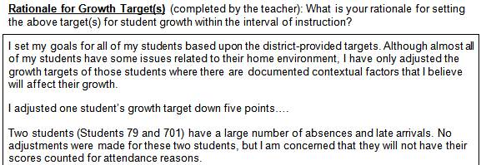
Rationale for Growth Targets
Essential element 1: Provides justification for both maintaining and adjusting targets for all students with contextual factors.
The teacher appropriately does not make adjustments for absences that are not directly connected to allowable contextual factors.
Notes:
When we look at our Rationale section however ***LASER***, it appears that the teacher has determined that not all of the absences are connected to allowable contextual factors and the teacher has appropriately indicated that two out of the three students will not receive adjustments because of this.

Slide 43
Rationale for Growth Targets
Essential element 1: Provides justification for both maintaining and adjusting targets for all students with contextual factors.
Notes:
Let’s look at another example that doesn’t focus on absences. Looking back at the Growth Targets section, we see that for our first student, Student 84,the teacher has proposed to adjust the target downward by 3 points, from174 to 171.

Slide 44
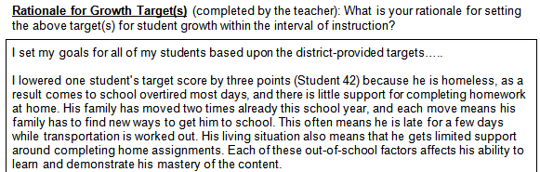
Rationale for Growth Targets
Essential element 1: Provides justification for both maintaining and adjusting targets for all students with contextual factors.
Notes:
***LASER***
Turning to the Rationale component, we first note that it appears the first essential element has been met. The teacher has provided a justification for the adjusted target in the context of an out-of-school factor, which is an allowable contextual factor.

Slide 45
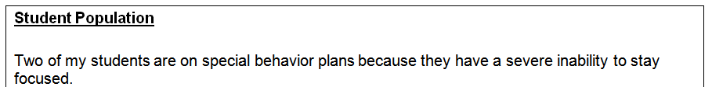
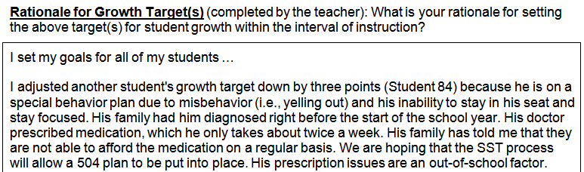
Rationale for Growth Targets
Essential element 2: Provides strong justification based on data for all adjusted growth targets, including effectively connecting contextual factors and baseline and trend data.
For Student 84
(one of the two students), the rationale expands on the student population description to provide a stronger link to allowable contextual factors to support downward adjustment
Notes:
The second essential element is that the rationale provides a strong justification based on data for all adjusted growth targets, including effectively connecting contextual factors and baseline and trend data. In other words. It’s not enough to merely identify an allowable contextual factor when justifying a target adjustment. The justification should be strong, by thoroughly describing how the contextual factor might impact growth.
**Laser**
When thinking about this essential element, consider whether enough information has been provided around the contextual factor to understand why it might impact student growth. Looking at the description of the contextual factor in the Student Population component, This brief sentence, while acceptable for the student population section, would probably not constitute a justification of acceptable strength for the Rationale section. The description of the behavioral challenges as described in the Rationale section ****expands significantly on the Student Population, providing much richer information that is probably meets the second essential element’s bar for strong justification. Enough information has been provided to understand how this contextual factor might impact student growth.

Slide 46
Rationale for Growth Targets
Essential element 3: Adjusts targets by magnitudes that are consistent with contextual factors and available data.
Essential element 4: Explains how targets align with broader school and district goals.
Student 84 was adjusted from the district-set target of 174 down to 171.
Notes:
We have noted that the 1st and 2nd essential elements for the Rationale ensure that an allowable justification is provided, and that the justification for adjustment is strong. The third and fourth essential elements ensure that the amount of the adjustment, otherwise referred to as the magnitude of the adjustment is consistent with the contextual factor as well as with school and district goals. In other words, does the amount of the adjustment fit the rationale for the adjustment?
In our example, the target for Student 84 was adjusted downward from 174 to 171, an adjustment of 3 points. For this essential elements, it is important once again to refer to the assessment-specific guidance provided on the TDES student growth measures page.

Slide 47
Growth Targets
Essential element 3: Adjusts targets by magnitudes that are consistent with contextual factors and available data.
Essential element 4: Explains how targets align with broader school and district goals.
Consult assessment-specific guidance for your preassessments and postassessments, as identified in Appendix D.
The teacher’s adjustment of -3 is the maximum suggested downward adjustment.
Notes:
In this case, the three-point adjustment does fall within the suggested range of adjustments, however, it is the maximum adjustment suggested. In this case, then, the reviewer might want to make sure that the rationale is explicit and strong enough to justify an adjustment at the high end of the suggested range of adjustments.

Slide 48
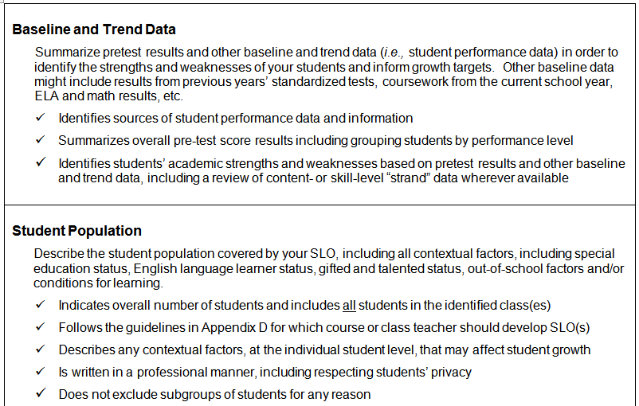

Collaborate to Get to SLO Approval!
Notes:
As this module has suggested, getting to SLO approval should be a collaborative process. As the SLO reviewer checks the SLO for the essential elements, they should at minimum be providing detailed written feedback to the teacher and ideally having face-to-face conversations.

Slide 49
Next Steps
Use the revised SLO Approval Checklist and other resources described to develop or review and approve SLOs by the deadlines indicated in the SLO Handbook:
  Guidance on Adjustments to Growth Targets: reasons for target adjustments
  Assessment-specific guidance: range of suggested target adjustments.
If you are a Teacher Development and Evaluation System (TDES) team member, and need additional information please email at SLO@clevelandmetroschool.org.
If you are a teacher, contact your school-based TDES team or principal for additional support.
Notes:
For your next steps, you should consult the SLO Handbook to determine the SLO submission deadline for the current school year.
SLO developers and reviewers should consult the various guidance identified in this module to develop or review SLOs, particularly the SLO approval checklist, to ensure that all of the essential elements of the SLO are included.
Teachers who are developing SLOs should talk to their school TDES team members with questions, and TDES team members should contact CMSD at the email address here with further questions
This concludes the professional learning module on Understanding the Essential Elements of the SLO Approval Checklist. Good luck with this year’s SLOs!

